Slide 1
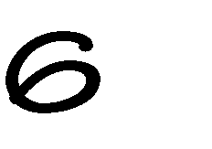
1

Slide 2
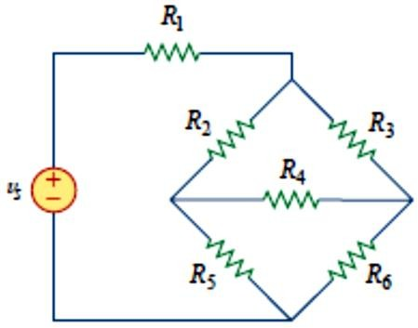
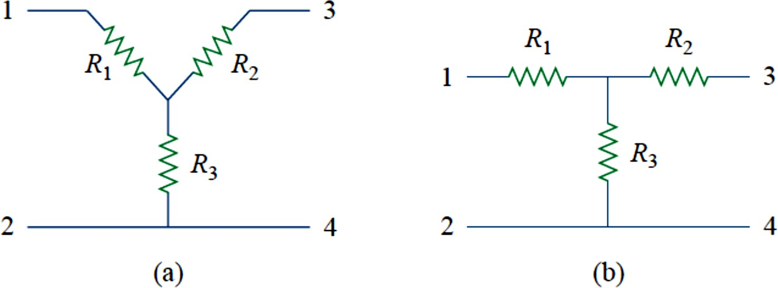
2
2-13 Wye-Delta Transformations
Situations often arise in circuit analysis when the resistors are neither in parallel nor in series. For example, consider the bridge circuit in Fig. 1.
How do we combine resistors 𝑅₁and 𝑅₆ through when the resistors are neither in series nor in parallel? Many circuits of the type shown in Fig. 1
Fig. 1
Can be simplified by using three-terminal equivalent networks. These are
the wye (Y) or tee (T) network shown in Fig. 2 and the delta (∆) or pi (Π) network shown in Fig. 3. These networks occur by themselves or as part of a larger network. They are used in three-phase networks, electrical filters, and matching networks. Our main interest here is in how to identify them when they occur as part of a network and how to apply wye-delta transformation in the analysis of that network.
Fig. 2
Two Forms of the same network: (a) Y, (b) T.

Slide 3
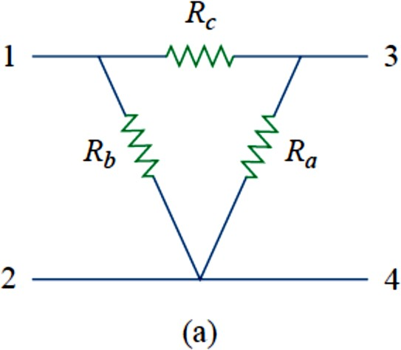
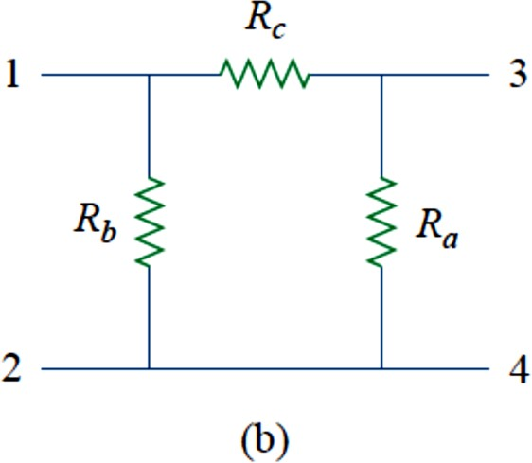
3
Fig. 3
Two Forms of the same network: (a) ∆, (b) Π.
Delta to Wye Conversion
Suppose it is more convenient to work with a wye network in a place
where the circuit contains a delta configuration. We superimpose a wye network on the existing delta network and find the equivalent resistances in the wye network. To obtain the equivalent resistances in the wye network, we compare the two networks and make sure that the resistance between each pair of nodes in the ∆ (or Π) network is the same as the resistance between the same pair of nodes in the Y (or T) network. For terminals 1 and 2 in Figs. 2 and 3, for example,
𝑅₁₂(𝑌) = 𝑅₁ + 𝑅₃
𝑅₁₂(∆) = 𝑅_{𝑏}‖(𝑅_{𝑎} + 𝑅_{𝑐})
Setting 𝑅₁₂(𝑌) = 𝑅₁₂(∆) gives
(1)
𝑅₁₂ = 𝑅₁ + 𝑅₃
𝑅_{𝑏}(𝑅_{𝑎} + 𝑅_{𝑐})
=
(2𝑎)
𝑅_{𝑎} + 𝑅_{𝑏} + 𝑅_{𝑐}
Similarly,
𝑅 = 𝑅₁ + 𝑅₂
𝑅_{𝑐}(𝑅_{𝑎} + 𝑅_{𝑏})
=
(2𝑏)
13
𝑅_{𝑎} + 𝑅_{𝑏} + 𝑅_{𝑐}
𝑅 = 𝑅₂ + 𝑅₃
𝑅_{𝑎}(𝑅_{𝑏} + 𝑅_{𝑐})
=
(2𝑐)
34
𝑅_{𝑎} + 𝑅_{𝑏} + 𝑅_{𝑐}

Slide 4
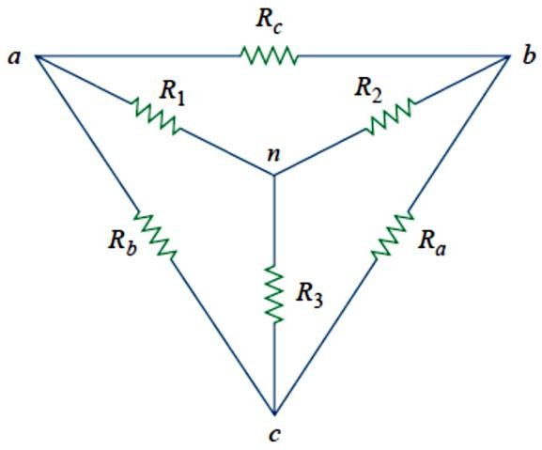
4
Subtracting Eq. (2c) from Eq. (2a), we get
𝑅₁ − 𝑅₂
𝑅_{𝑐}(𝑅_{𝑏} − 𝑅_{𝑎})
=
(3)
𝑅_{𝑎} + 𝑅_{𝑏} + 𝑅_{𝑐}
Adding Eqs. (2b) and (3) gives
𝑅_{𝑏}𝑅_{𝑐}
𝑅₁ = _{𝑅}
(4)
+ 𝑅 + 𝑅
𝑎 𝑏 𝑐
And subtracting Eq. (3) from Eq. (2b) yields
𝑅_{𝑐}𝑅_{𝑎}
𝑅₂ = _{𝑅}
(5)
+ 𝑅 + 𝑅
𝑎 𝑏 𝑐
Subtracting Eq. (4) from Eq. (2a), we obtain
𝑅_{𝑎}𝑅_{𝑏}
𝑅₃ = _{𝑅}
(6)
+ 𝑅 + 𝑅
𝑎 𝑏 𝑐
We do not need to memorize Eqs. (4) to (6). To transform a network to Y, we create an extra node n as shown in Fig. 2.49 and follow this conversion rule:
Each resistor in the Y network is the product of the resistors in the two adjacent ∆ branches, divided by the sum of the three ∆ resistors.
One can follow this rule and obtain Eqs. (4) to (6) from Fig. 4.
Fig. 4
Superposition of Y and networks as an aid in transforming one to the other.

Slide 5
5
Wye to Delta Conversion
To obtain the relationships necessary to convert from a Y to a ∆, first divide Eq. (6) by Eq. (4):
𝑅₃ (𝑅_{𝑎}𝑅_{𝑏})⁄(𝑅_{𝑎} + 𝑅_{𝑏} + 𝑅_{𝑐}) 𝑅_{𝑎}
𝑅 ⁼ (𝑅 𝑅 )⁄(𝑅 + 𝑅 + 𝑅 ) ⁼ 𝑅
1 𝑏 𝑐 𝑎 𝑏 𝑐 𝐶
Or
𝑅_{𝑐}𝑅₃
𝑅 =
𝑎
𝑅₁
Then divide Eq. (6) by Eq. (5)
𝑅₃ (𝑅_{𝑎}𝑅_{𝑏})⁄(𝑅_{𝑎} + 𝑅_{𝑏} + 𝑅_{𝑐}) 𝑅_{𝑏}
𝑅 ⁼ (𝑅 𝑅 )⁄(𝑅 + 𝑅 + 𝑅 ) ⁼ 𝑅
2 𝑎 𝑐 𝑎 𝑏 𝑐 𝑐
Or
𝑅_{𝑐}𝑅₃
𝑅 =
𝑏
𝑅₂
Substituting for 𝑅_{𝑎} and 𝑅_{𝑏} in Eq. (5) yields
𝑅 =
(𝑅_{𝑐}𝑅₃⁄𝑅₁)𝑅_{𝑐}
2
(𝑅₃𝑅_{𝑐}⁄𝑅₂) + (𝑅_{𝑐}𝑅₃⁄𝑅₁) + 𝑅_{𝑐} (𝑅₃⁄𝑅₁)𝑅_{𝑐}
⁼ (𝑅 ⁄𝑅 ) + (𝑅 ⁄𝑅 ) + 1
3 2 3 1
Placing these over a common denominator, we obtain
𝑅 =
(𝑅₃𝑅_{𝑐}⁄𝑅₁)
2
(𝑅 𝑅 + 𝑅 𝑅 + 𝑅 𝑅 )⁄(𝑅 𝑅 )
1 2
1 3 2 3 1 2
𝑅₂𝑅₃𝑅_{𝑐}
=
𝑅₁𝑅₂ + 𝑅₁𝑅₃ + 𝑅₂𝑅₃
And
𝑅_{𝑐} =
𝑅₁𝑅₂ + 𝑅₁𝑅₃ + 𝑅₂𝑅₃
𝑅
(7)
3
We follow the same procedure for 𝑅_{𝑏} and 𝑅_{𝑎}:

Slide 6
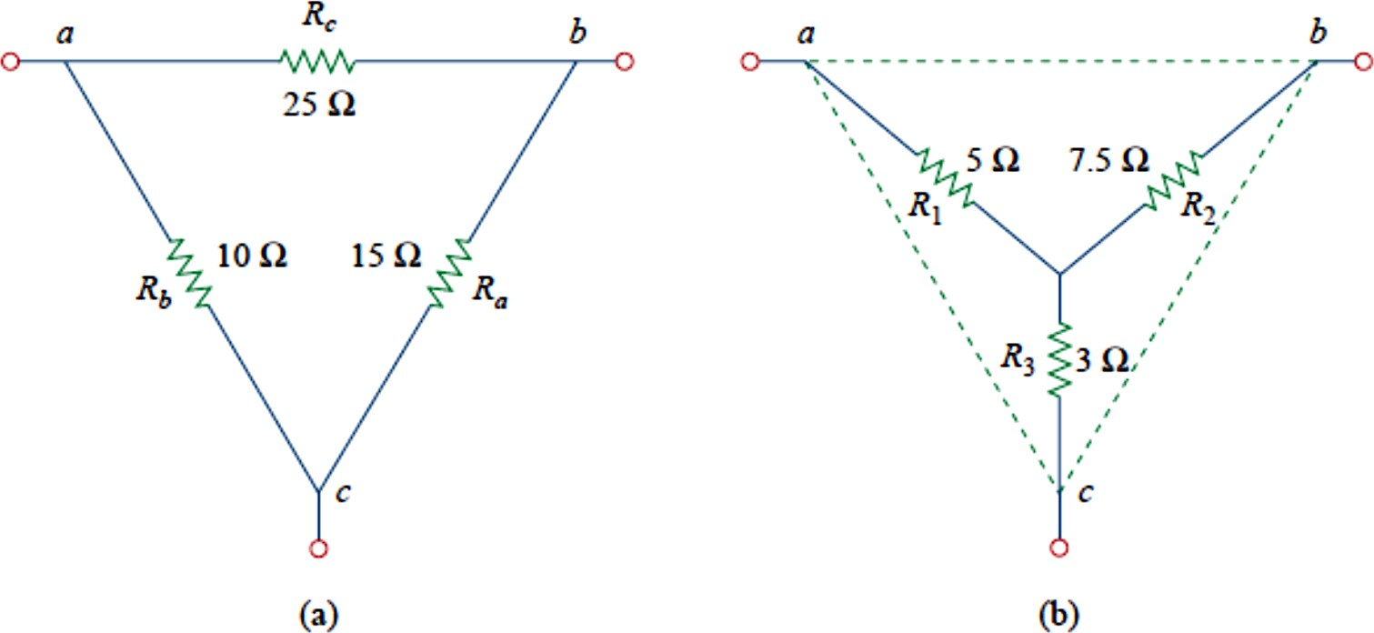
6
𝑅_{𝑎} =
𝑅₁𝑅₂ + 𝑅₁𝑅₃ + 𝑅₂𝑅₃
𝑅
(8)
1
And
𝑅_{𝑏} =
𝑅₁𝑅₂ + 𝑅₁𝑅₃ + 𝑅₂𝑅₃
𝑅
(9)
2
Each resistor in the ∆ network is the sum of all possible products of Y resistors taken two at a time, divided by the opposite Y resistor.
The Y and ∆ networks are said to be balanced when
𝑅₁ = 𝑅₂ = 𝑅₃ = 𝑅_{𝑌}, 𝑅_{𝑎} = 𝑅_{𝑏} = 𝑅_{𝑐} = 𝑅∆,
Under these conditions, conversion formulas become
𝑅∆
𝑅_{𝑌} = ₃ 𝑜𝑟 𝑅∆ = 3𝑅_{𝑌}
Example 1: Convert the ∆ network in Fig. 5a to an equivalent Y network
Fig.5
For Example 5: (a) original ∆ network, (b) Y equivalent network.

Slide 7
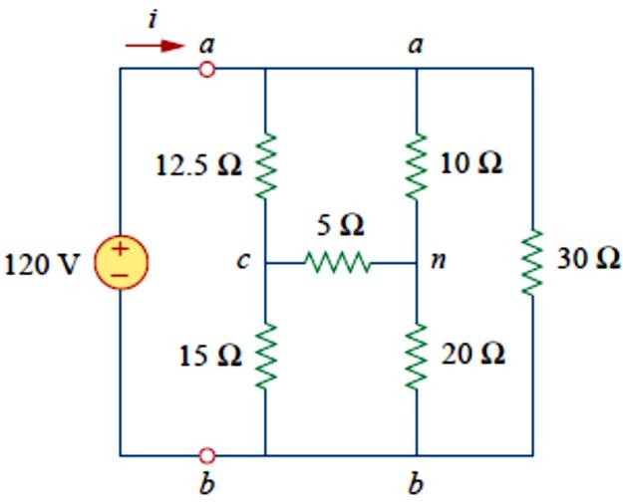
7
Solution:
𝑅 =
𝑅_{𝑏}𝑅_{𝑐} 10 × 25
250
= = 5Ω
1
=
𝑅_{𝑎} + 𝑅_{𝑏} + 𝑅_{𝑐} 15 + 10 + 25 50
𝑅 =
𝑅_{𝑐}𝑅_{𝑎} 25 × 15
375
= = 7.5Ω
2
=
𝑅_{𝑎} + 𝑅_{𝑏} + 𝑅_{𝑐} 15 + 10 + 25 50
𝑅 =
𝑅_{𝑎}𝑅_{𝑏} 10 × 15
150
= = 3Ω
3
=
𝑅_{𝑎} + 𝑅_{𝑏} + 𝑅_{𝑐} 15 + 10 + 25 50
The equivalent Y network is shown in Fig. 5(b).
Example 2: Obtain the equivalent resistance 𝑹_{𝒂𝒃} for the circuit in Fig. 6 and use it to find current i.
Fig. 6
H.W. 1:For the bridge network in Fig. 7, find 𝑹_{𝒂𝒃} and i.
𝐴𝑛𝑠𝑤𝑒𝑟: 40Ω, 2.5 𝐴.

